Slide 1

Object Oriented Programming-I
CS-322
Operators and Control Structures in C++
June 2020
Instructor: Bilal Jan

Slide 2

Outlines
Before coding, paper work is essential
Operator types in C++
C++ Control Structures
Repetition structures

Slide 3
Paper work
Before writing a Program
Understand the problem well
Think about possible solution(s).
Write algorithm in simple statements or in pseudocode form
If the algorithm is implementable, think about the available building blocks/programming constructs (possible variables & types, user/pre defined functions, conditional & iterative constructs, links to built in functions & classes etc)
Start writing the source code based on the algorithm/design strategy
Once you have succeeded in writing a solution program, its time to optimize it.
Pardon for optimization (its often hard but never impossible)
Program

Slide 4
Operators in C++
Arithmetic operators
Relational operators
Logical operators
Assignment operator
Bitwise operators.

Slide 5
Arithmetic operators
Arithmetic operator | Description | Example
+ | Used for addition. Binary operator requiring two operands/constants | int a=10,b=2,d; int c=a+b; //c=12; d=a+100; //d=110;
- | Used for subtraction. Binary operator requiring two operands/constants | int a=10,b=2,d; int c=a-b;//c=2; d=a-100;//d=-90;
* | Used for multiplication. Binary operator requiring two operands/constants | int a=10,b=2,d; int c=a*b; //c=20; d=a*100; //d=1000;
/ | Used for division. Binary operator requiring two operands/constants | int a=10,b=2,d; int c=a/b; //c=5; d=100/a;//d=10;
% | Returns reminder. Binary operator requiring two operands/constants | int a=10,b=2,d; int c=a%b;//c=0 d=a%3;//d=1
++ | Unary operator that increments operand current value by 1 | int a=10,d; a++; //a=11; d=++a;//d=12
-- | Unary operator that decrements operand current value by 1 | int a=10,d; a--; //a=9; d=--a;//d=8
Used for basic arithmetic operations

Slide 6
Relational Operators
Relational Operator | Description | Example | Return value
== | Equal to | ( 1 == 1 ) | true
!= | Not equal to | (1 != 2 ) | true
> | Greater than | ( 1 > 2 ) | false
< | Less than | ( 2 < 1 ) | false
>= | Grater than or equal to | ( 9 >= 9 ) | true
<= | Less than or equal to | ( 5 <= 15 ) | True
Allow comparisons & checking relationship a.k.a Comparison operators
Require two operands at left
and right (binary)
Results in true or false
Widely used as condition in selection and repetition structures.

Slide 7
Logical operators
Logical operators evaluates more than one expression values
Return value is bolean (true or false)
Logical operators are
AND operator denoted by &&
OR operator denoted by ||
NOT operator denoted by !
AND (&&) and OR (||) are binary operators requiring left and right expressions
NOT (!) is a unary operator that operates on a single expression

Slide 8
Logical Operators
int A,B,C; A =10; B=20; C=0;
Logical Operator | Description | Example | Return value
&& | AND operator | ( (A=>10) && (A>B) ) | false
|| | OR operator | ( (A=>10) || (A>B) ) | true
! | NOT operator | ( !C ) | true
Input 1 | Input 2 | Input1 && Input2 | Input1 || Input2 | !(Input1) | !(Input2)
0 | 0 | 0 | 0 | 1 | 1
1 | 0 | 0 | 1 | 0 | 1
0 | 1 | 0 | 1 | 1 | 0
1 | 1 | 1 | 1 | 0 | 0
Truth table

Slide 9
Bitwise Operators
bitwise operator | Description | Example
& | Used for bitwise AND operation of the two operands at left and right. | 5= 0101 6= 0110 5&6= 0100 0100->4
| | Used for bitwise OR operation of the two operands at left and right. | 5= 0101 6= 0110 5|6= 0111 0111->7
^ | Used for bitwise XOR operation of the two operands at left and right. | 5= 0101 6= 0110 5^6= 0011 0011->3
<< | Takes two operands OP1 and OP2. Left shifts the bits of OP1 by number of places as specified by OP2. | 5= 0101 6= 0110 (5<<1)=10 (6<<1)=12
>> | Takes two operands OP1 and OP2. Right shifts the bits of OP1 by number of places as specified by OP2. | 5= 0101 6= 0110 (5>>1)=2 (6>>1)=3
~ | Unary operator that inverts the bits of the single provided operand. | 5=0101 ~5=-6 6=0110 ~6=-7
AND operation as &
OR operation as |
XOR operation as ^
Left shift <<
Right shift >>
Complement operator ~
All operations are performed on binary whereas result is showed in equivalent decimal value

Slide 10
Program on bitwise operators
#include <iostream>
using namespace std;
int main() {
int a = 5, b = 6;
//5=00000101,6=00000110
cout << "a = " << a << endl;
cout << "b = " << b << endl;
cout << "a & b = " << (a & b) << endl;
cout << "a | b = " << (a | b) << endl;
cout << "a ^ b = " << (a ^ b) << endl;
cout<<"~a = "<<~a<<endl;
cout<<"~b = "<<~b<<endl;
cout<<"a >> 1 = "<<(a>>1)<<endl;
cout<<"b >> 1 = "<<(b>>1)<<endl;
cout<<"a << 1 = "<<(a<<1)<<endl;
cout<<"b << 1 = "<<(b<<1)<<endl;
return 0;
}
a = 5
b = 6
a & b = 4
a | b = 7
a ^ b = 3
~a = -6
~b = -7
a >> 1 = 2
b >> 1 = 3
a << 1 = 10
b << 1 = 12

Slide 11
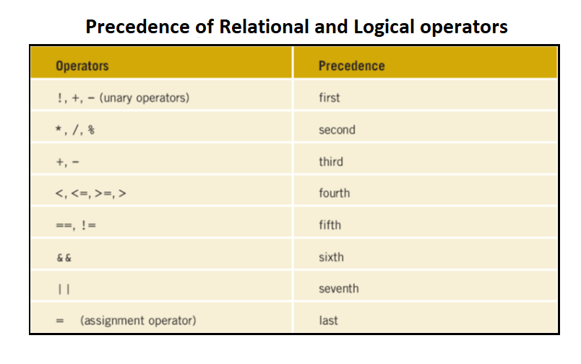
Operator’s precedence
For same precedence level
Rule is left to right execution

Slide 12
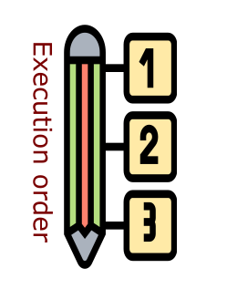
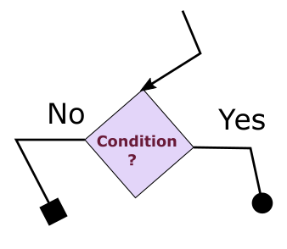

C++ Control Structures
Sequence Structure
Left to right
Top to bottom
Sequential just like stepping down the ladder
Selection Structure
Single action. Execute some thing based on some happening
Binary action. Execute two different things one when condition is met and vice versa.
Multiple. When a range a possibilities rather a simple true or false cases.
Repetition structures
A statement or a group of statements which are repeated/iterated in a controlled way.
Condition based iteration
Entry and exit points framed by the condition inplaced.

Slide 13
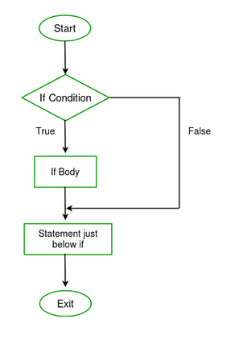
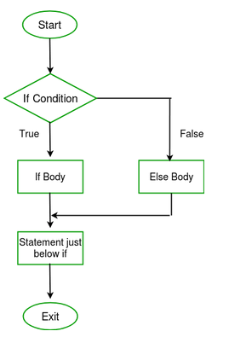
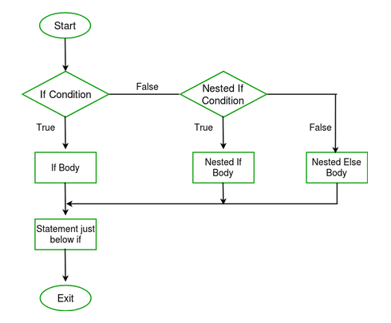
Selection Structure
Execute when condition is met if statement
Execute on Yes/No basis. If-else statement
Multiple Selection. If-elseif…else and switch statement
Source: https://www.geeksforgeeks.org/decision-making-c-c-else-nested-else/

Slide 14
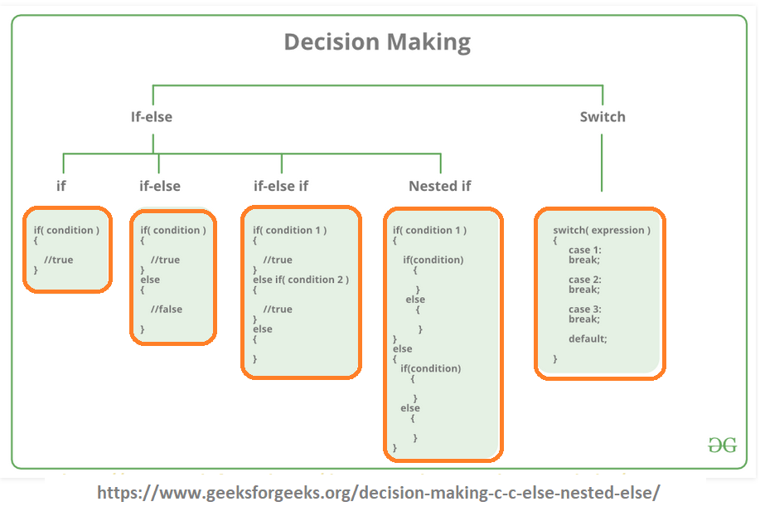
For Syntax→ over to program

Slide 15
if statement
one-way selection
The condition is a logical expression that results in true or false i.e. a boolean value
Relational operators:
Allow comparisons
Require two operands at left and right (binary)
Results in true or false
The body of if statement is condition for any true value.
Body is executed for any non-zero value for condition
If (condition)
{
statement1;
statement2;
…
statement;
}
Syntax→

Slide 16
If statement
#include <iostream>
using namespace std;
int main() {
int input;
cout<<"Enter any value greater than 7" <<endl;
cin>>input;
if(input>7){
cout<<"Entered value is greater than 7 "<<endl;
}
cout<<"C++ control structures are very effective"<<endl;
}
Enter any value greater than 7
6
C++ control structures are very effective
Enter any value greater than 7
8
Entered value is greater than 7
C++ control structures are very effective

Slide 17
If-else statement as two-way selection
#include <iostream>
using namespace std;
int main() {
int input;
cout<<"Enter any positive value" <<endl;
cin>>input;
if(input>0){
cout<<"Entered value is positive"<<endl;
}
else
{
cout<<"Entered value is negative"<<endl;
}
cout<<"C++ if-else control structure is very useful"<<endl;
}
Enter any positive value
9
Entered value is positive
C++ if-else control structure is very useful
Enter any positive value
-3
Entered value is negative
C++ if-else control structure is very useful

Slide 18
If-elseif-else statement as multiple selection
#include <iostream>
using namespace std;
int main() {
int obtainedMarks;
char grade='#';
cout<<"Enter marks obtained in OOP-I course" <<endl;
cin>>obtainedMarks;
if(obtainedMarks<50)
grade = 'F';
else if(obtainedMarks>=50 && obtainedMarks<60)
grade = 'D';
else if(obtainedMarks>=60 && obtainedMarks<=71)
grade = 'C';
else if(obtainedMarks>71 && obtainedMarks<=84)
grade = 'B';
else if(obtainedMarks>84 && obtainedMarks<=100)
grade = 'A';
else
cout<<"Wrong value for obtainedMarks"<<endl;
cout<<"Grade is "<<grade;
}
Enter marks obtained in OOP-I course
62
Grade is C
Enter marks obtained in OOP-I course
49
Grade is F
Enter marks obtained in OOP-I course
101
Wrong value for obtainedMarks
Grade is #

Slide 19
switch control structure
The expression is evaluated first and once
The resultant value of expression is checked against each case type and for a match:
The body of the case type is executed
Until break statement is encountered
In case when result of expression has no match case type
The default body is executed
There is no break after default
switch(expression) { case A: // body A break; case B: // body B break;
… default: // body default }
Syntax→

Slide 20
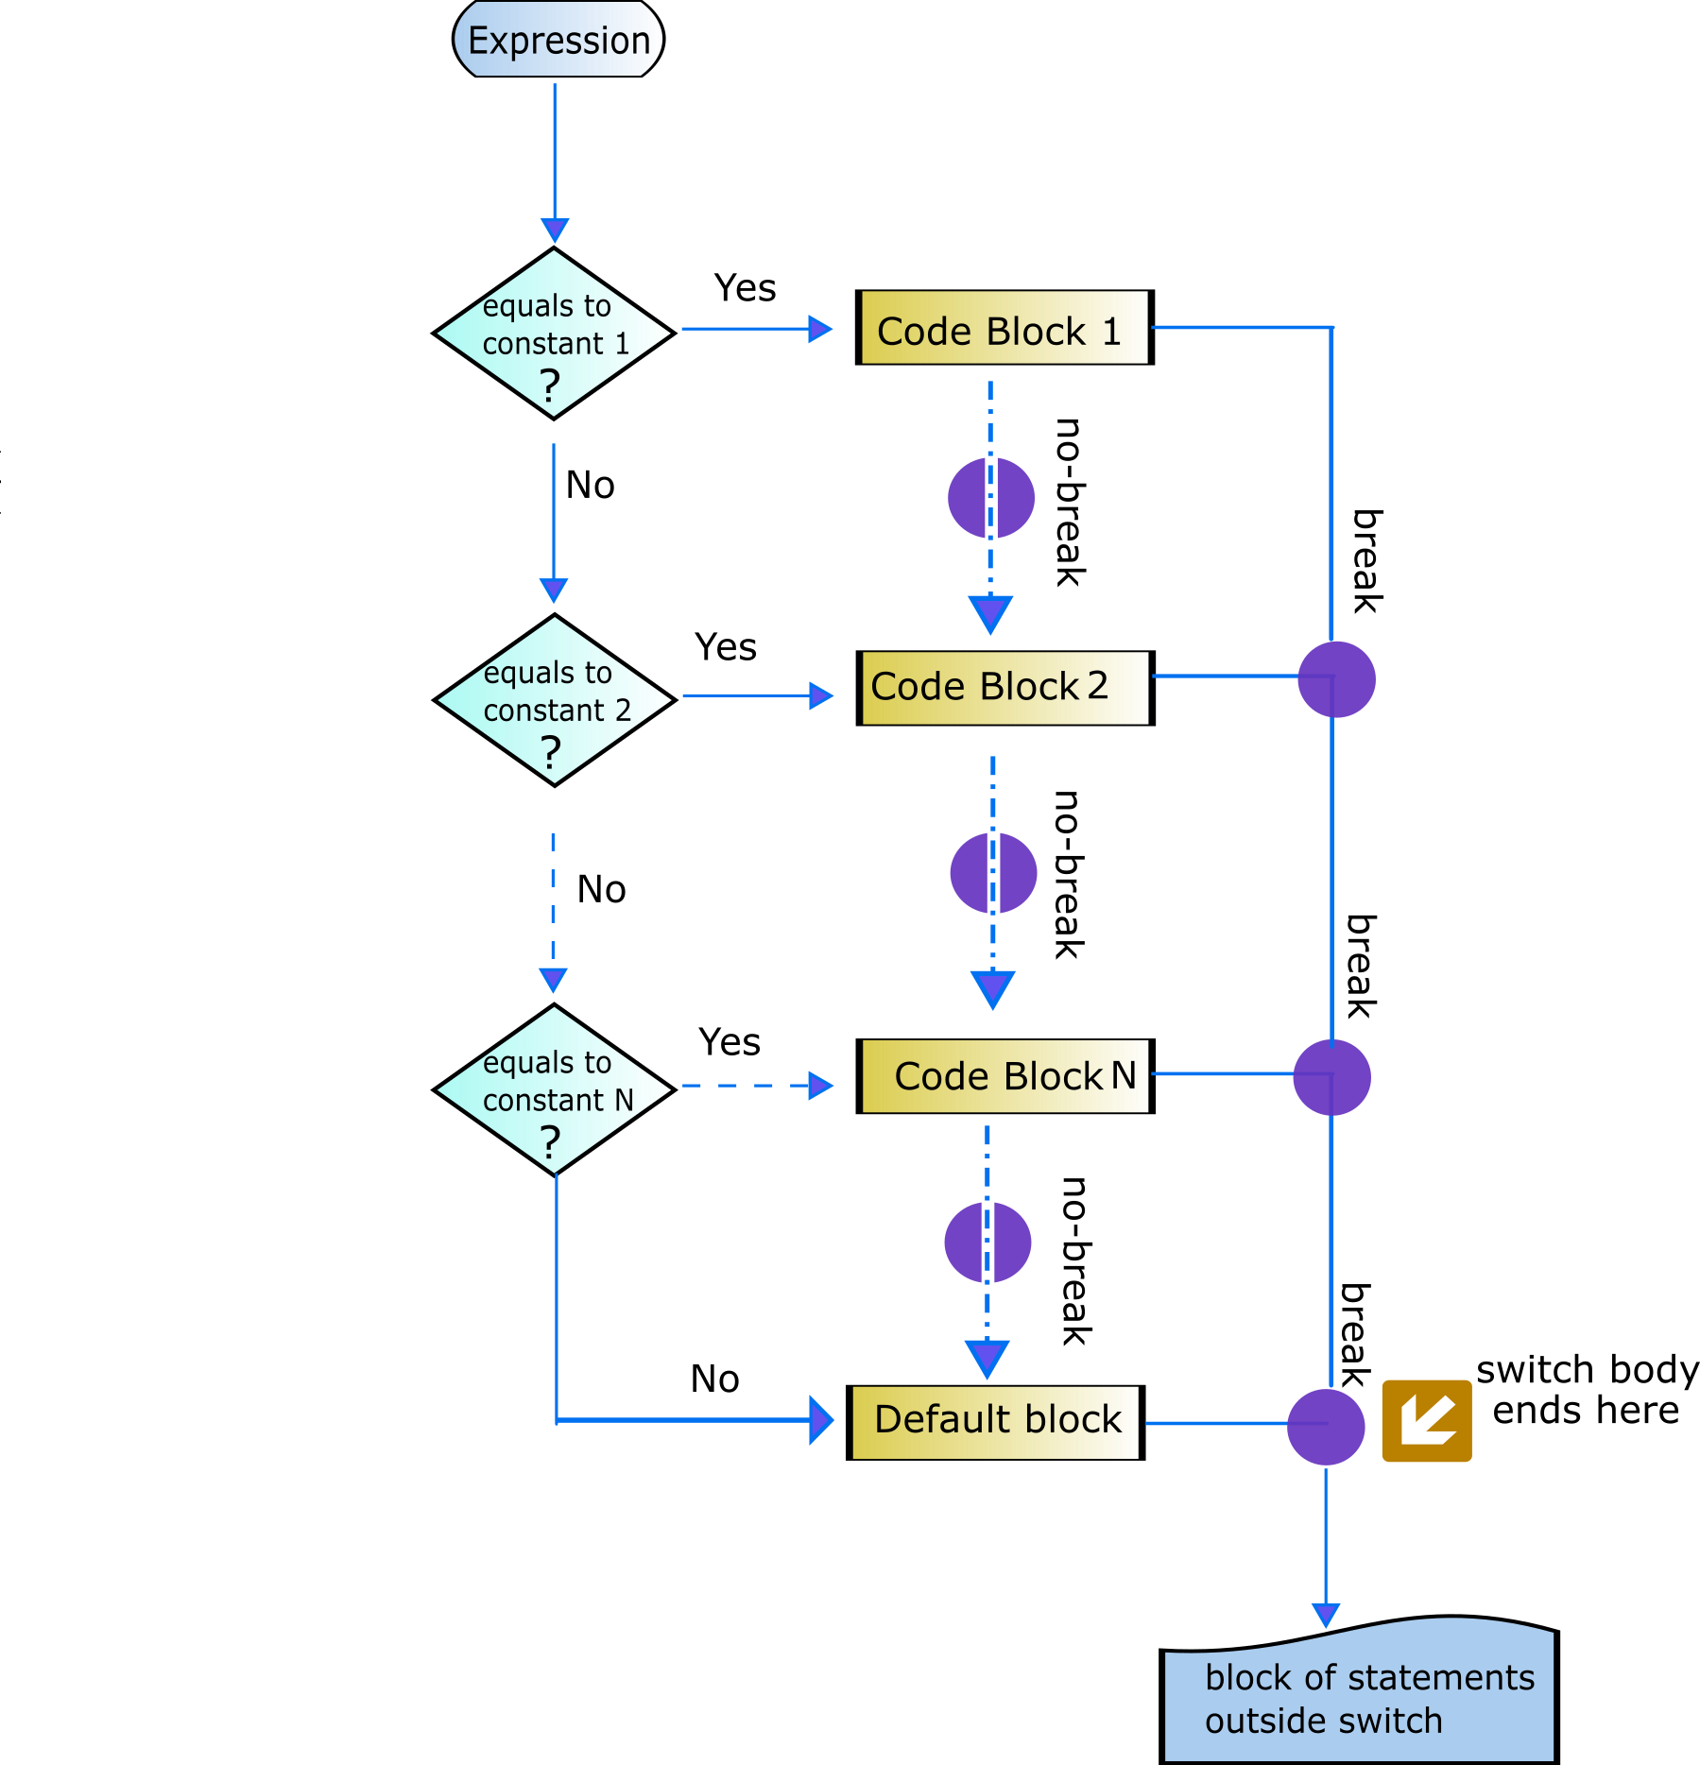
switch control structure

Slide 21
switch statement
#include <iostream>
using namespace std;
int main() {
int monthNumber;
cout<<"Enter any month number 1-12"<<endl;
cin>>monthNumber;
switch(monthNumber){
case 1:
cout<<"Entered monthNumber name is January"<<endl;
break;
case 2:
cout<<"Entered monthNumber name is February"<<endl;
break;
case 3:
cout<<"Entered monthNumber name is March"<<endl;
break;
case 4:
cout<<"Entered monthNumber name is April"<<endl;
break;
case 5:
cout<<"Entered monthNumber name is May"<<endl;
break;
case 6:
cout<<"Entered monthNumber name is June"<<endl;
break;
case 7:
cout<<"Entered monthNumber name is July"<<endl;
break;
case 8:
cout<<"Entered monthNumber name is August"<<endl;
break;
case 9:
cout<<"Entered monthNumber name is September"<<endl;
break;
case 10:
cout<<"Entered monthNumber name is October"<<endl;
break;
case 11:
cout<<"Entered monthNumber name is November"<<endl;
break;
case 12:
cout<<"Entered monthNumber name is December"<<endl;
break;
default:
cout<<"Wrong number entered. Out of range 1-12"<<endl;
}
cout<<"End of Program"<<endl;
return 0;
}
Enter any month number 1-12
2
Entered monthNumber name is February
End of Program
Enter any month number 1-12
12
Enter monthNumber name is December
End of Program
Enter any month number 1-12
0
Wrong number entered. Out of range 1-12
End of Program

Slide 22
Nested selective structures
Selective structures can be nested i.e. one selective structure inside the body of another
Provides better control and logic execution
Program and examples in Eclipse

Slide 23
Selection as Conditional operator ?:
Is a ternary operator that take three expressions
Can be used as alternative to if-else selection
Is very compact and easy to read
Widely used as condition-based variable initialized
#include <iostream>
using namespace std;
int main() {
int A,B,max,min;
A=10;
B=20;
max=(A > B ? A : B);
min= (B < A ? B : A);
cout<<"Maximum is "<<max<<endl;
cout<<"Minimum is "<<min;
}
Syntax
(expression1 ? expression2 : expression3)
Maximum is 20
Minimum is 10

Slide 24
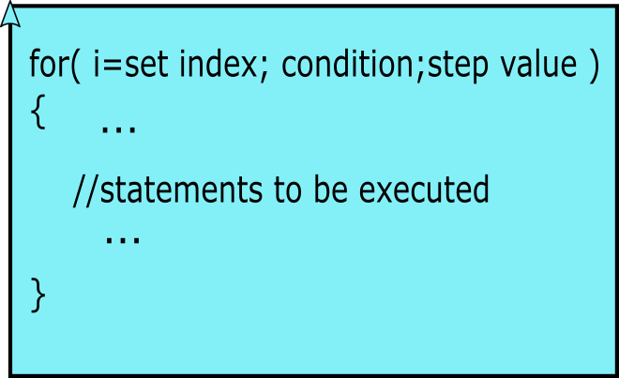
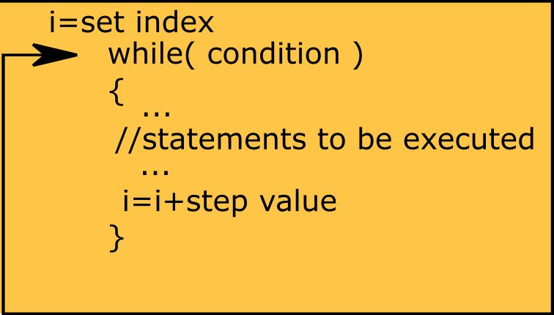
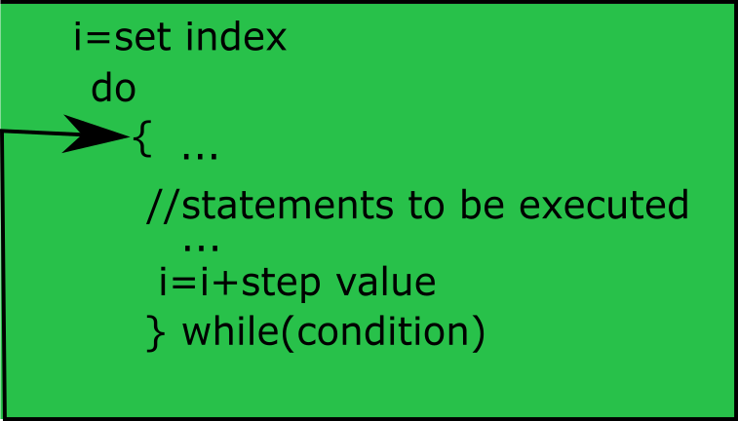
Repetition Structure
for loop
while loop
do while loop Selection.

Slide 25
for loop
Basic structure for iteration
Widely used
Has some variations/flexibility in use
for-each very powerful for accessibility

Slide 26
for loop example program
#include <iostream>
using namespace std;
int main() {
int num;
int i;
cout<<"Program that takes 3 input values "<<endl;
cout<<"and returns the squared value "<<endl;
for(i=0;i<3;i++){
cout<<"Enter Input No "<<i+1<<endl;
cin>>num;
cout<<"Square is "<<num*num<<endl;
}
cout<<"End of Program"<<endl;
}
Program that takes 3 input values
and returns the squared value
Enter Input No 1
2
Square is 4
Enter Input No 2
5
Square is 25
Enter Input No 3
7
Square is 49
End of Program

Slide 27
While loop
Has the same working as for loop
Index variable is initialized first
Condition is checked as second step
Block of code inside the body is executed
Step-value is normally changed inside the body or as last statement.

Slide 28
while loop example program
#include <iostream>
using namespace std;
int main() {
int input;
int step=1;
cout<<"Program that prints table of the input value"<<endl;
cout<<"Enter any number "<<endl;
cin>>input;
cout<<"Table of "<<input<<endl;
while(step<=10){
cout<<step<<" x "<<input<<" ="<<input*step<<endl;
step++;
}
cout<<"End of Program"<<endl;
}
Program that prints table of the input value
Enter any number
5
Table of 5
1 x 5 = 5
2 x 5 = 10
3 x 5 = 15
4 x 5 = 20
5 x 5 = 25
6 x 5 = 30
7 x 5 = 35
8 x 5 = 40
9 x 5 = 45
10 x 5 = 50
End of Program

Slide 29
do-while loop
Used in situation(s) where one wants to executed statement(s) at least once.
Condition is checked after the block/loop-body is executed
Step-value is normally changed inside the body or as last statement.
Even for wrong condition the body is executed at least once making do-while unique

Slide 30
do-while loop example program
#include <iostream>
using namespace std;
int main() {
int n,factorial=1;
int flagCheck;
cout<<"Program that prints factorial of input value"<<endl;
cout<<"Program stops when user enters 0"<<endl;
do{
cout<<"Enter any positive number "<<endl;
cin>>n;
if(n>0){
for(int i=n;i>0;i--){
factorial=factorial*i; //factorial=n*(n-1)*(n-2)...*1
}
}
cout<<"factorial of "<<n<<" is "<<factorial<<endl;
cout<<"do you want to continue. 0-> stop, 1->continue"<<endl;
factorial=1;
cin>>flagCheck;
}while(flagCheck);
cout<<"End of Program"<<endl;
}
Program that prints factorial of input value
Program stops when user enters 0
Enter any positive number
4
factorial of 4 is 24
do you want to continue. 0-> stop, 1->continue
1
Enter any positive number
6
factorial of 6 is 720
do you want to continue. 0-> stop, 1->continue
0
End of Program

Slide 31
Nested repetition structures
Repetition structures can be nested i.e. one loop structure inside the body of another
Provides better control and logic execution
Program and examples in Eclipse
*
**
***
****
*****
******
*******
********
*********
**********
**********
*********
********
*******
******
*****
****
***
**
*

Slide 32
Coming Up NEXT
Array in C++

